Slide 1



Malaviya Mission Teacher Training Programme (MMTTP)
UGC : Malaviya Mission Teacher Training Centre
SAURASHTRA UNIVERSITY
2nd Regional Workshop
Central & Western Zone
31st January – 01st February, 2025
under

Slide 2
Programme Overview
2023-24
UGC : MMTTC SAURASHTRA UNIVERSITY | NEP Orientation & Sensitization Program |  | Faculty Induction Program |  | Short Term Program |  | Refresher Course |  | Total no. of programmes & beneficiaries
 | No. of Programmes | No. of Beneficiaries (PRESENT+ ABSENT) | No. of Programmes | No. of Beneficiaries (PRESENT+ ABSENT) | No. of Programmes | No. of Beneficiaries (PRESENT+ ABSENT) | No. of Programmes | No. of Beneficiaries (PRESENT+ ABSENT) | No. of Programmes | No. of Beneficiaries (PRESENT+ ABSENT)
 | 06 | 697 (439+258) | 03 | 154 (119+35) | 00 | -- | 03 | 139 (123+16) | 12 | 990 (681+309)
2024-25
UGC : MMTTC SAURASHTRA UNIVERSITY | NEP Orientation & Sensitization Program |  | Faculty Induction Program |  | Short Term Program |  | Refresher Course |  | Total no. of programmes & beneficiaries
 | No. of Programmes | No. of Beneficiaries (PRESENT+ ABSENT) | No. of Programmes | No. of Beneficiaries (PRESENT+ ABSENT) | No. of Programmes | No. of Beneficiaries | No. of Programmes | No. of Beneficiaries | No. of Programmes | No. of Beneficiaries
 | 06 | 584 (389+195) | 02 | 149 (67+82) | 03 | 309 (165+144) | 04 | 248 (176+72) | 15 | 1290 (797+493)

Slide 3
Financial Utilisation
2023-24 |  | 2024-25
Funds released (Rs. in Lakhs) | Funds utilized (as per PFMS) (Rs. in Lakhs) | Funds released (Rs. in Lakhs) | Funds utilized (as per PFMS) (Rs. in Lakhs)
HRDC GRANT - 85.3882 | 85.3881 | 40.0000 | 40.0000
MMTTC GRANT - 16.7470 | 1.3800 | 8.6404 | 8.6403
MMTTC GRANT |  | 10.0000 | 9.9967

Slide 4
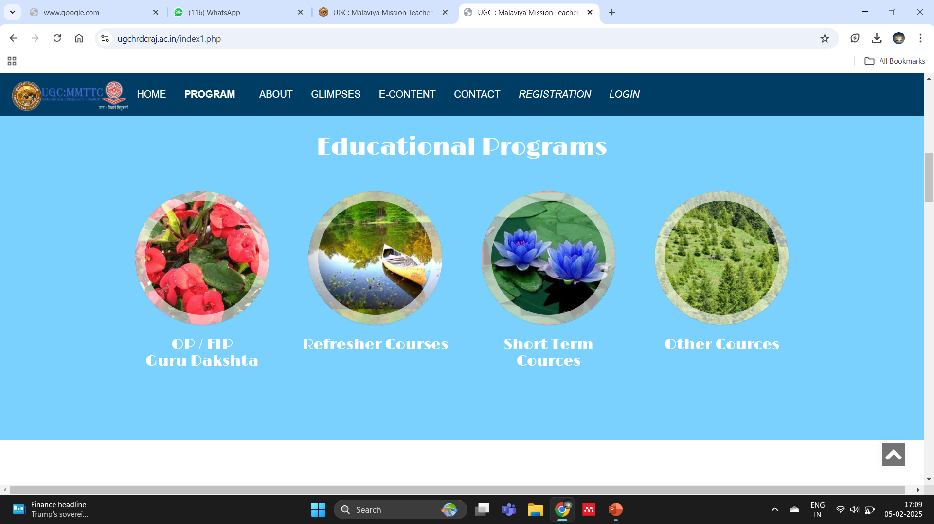
Outreach & Dissemination Efforts
Website Announcements

Slide 5
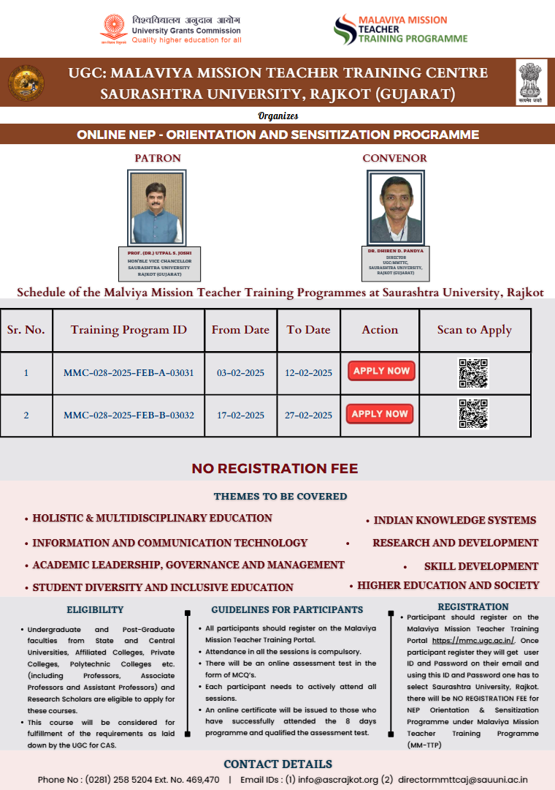
Outreach & Dissemination Efforts
Email Campaigns
WhatsApp Group
Social Media
Online Meetings
Direct Communication with Principals and VC of University

Slide 6
Best Practices
List of innovative approaches and successful strategies implemented
  Yoga & Prayer
  Visits to Cultural & Historic Places
  Assessment & Feedback System For Resource Person
  We encourage teachers to reflect on their teaching experiences through discussions and peer reviews to foster continuous improvement.
  We allow teachers to specialize in areas of interest or need, such as special educational pedagogy.

Slide 7
Challenges (if any)
Decreasing response on offline Programmes
Low number of newly appointed teachers in the region
Uncertain Presence of participants in online mode
High Drop Out Ratio

Slide 8
Follow-up with Beneficiaries, Feedback & Impact Assessment
FOLLOW UP:
Methods of engagement post-workshop
Surveys & Feedback
Participants reviews in concluding sessions

Slide 9
Resource Persons (FIP & OP)
Sr. No. | Name of Resouece Person | Expertise | Affiliation | FIP/Date | Session
1 | Prof. Hitesh Shukla | Skill Development | Department of Business Administration, Saurashtra University, Rajkot. | FIP-128 From 11/09/2023 to 07/10/2023 | 2
 |  |  |  |  | 2
2 | Dr. Ashvini Joshi | Information and Communication Technology | Department of Nanoscience and Advanced materials, Saurashtra University | FIP-130 From 26/02/2024 to 23/03/2024 | 2
 |  |  |  |  | 2
3 | Dr. Narendrabhai Dave | Academic Leadership, Governance & Management | GOG | FIP-130 From 26/02/2024 to 23/03/2024 | 1
 |  | Academic Leadership, Governance & Management |  |  | 1
4 | Dr. Dilip Ahir | Information and Communication Technology, Higher Education and Society | Government Engineering College, Rajkot | FIP-130 From 26/02/2024 to 23/03/2024 | 2
 |  |  |  | FIP-129 From 08/01/2024 to 03/02/2024 | 2
 |  |  |  |  | -
5 | Prof. A.D. Ambasana | Higher Education and Society | Saurashtra University, Rajkot | FIP-130 From 26/02/2024 to 23/03/2024 | 2
 |  |  |  |  | 2
6 | Dr. Rajendra Chotalia | Skill Development | Dept. of Sanskrit, Saurashtra University, Rajkot | FIP-130 From 26/02/2024 to 23/03/2024 | 2
 |  |  |  |  | 2
 |  |  |  | FIP-129 From 08/01/2024 to 03/02/2024 | 2
 |  |  |  |  | 2
7 | Mrs. Ushmaben Vani | Yoga | Freelance | FIP-130 From 26/02/2024 to 23/03/2024 | 2
 |  |  |  | FIP-128 From 11/09/2023 to 07/10/2023 | -
 |  |  |  |  | 2
8 | Dr. Dhiren Pandya | Academic Leadership, Governance & Management | UGC:MMTTC, Saurashtra University, Rajkot | FIP-130 From 26/02/2024 to 23/03/2024 | 1
 |  |  |  |  | 1
 |  |  |  |  | 2
 |  |  |  | FIP-129 From 08/01/2024 to 03/02/2024 | -
 |  |  |  |  | -
 |  |  |  |  | 1
 |  |  |  |  | 1
 |  |  |  | FIP-128 From 11/09/2023 to 07/10/2023 | 2
 |  |  |  |  | 1
9 | Swami Shri Nikhileshvar Mj. | Holistic & Multidisciplinary Education, Indian Knowledge Systems | Ramakrishna Ashram | FIP-128 From 11/09/2023 to 07/10/2023 | 2
10 | Dr. Nidatt Barot |  |  | FIP-128 From 11/09/2023 to 07/10/2023 | 2
11 | Dr. Nayan Jobanputra | Information and Communication Technology | Saurashtra University, Rajkot | FIP-130 From 26/02/2024 to 23/03/2024 | 2
12 | Prof. Sanjay Bhayani | Student Diversity and inclusive, Academic Leadership, Governance & Management | Department of Business Administration, Saurashtra University, Rajkot | FIP-130 From 26/02/2024 to 23/03/2024 | 2
 |  |  |  | FIP-129 From 08/01/2024 to 03/02/2024 | -
 |  |  |  | FIP-128 From 11/09/2023 to 07/10/2023 | 2
 |  |  |  |  | 2
13 | Prof. B.R. Kataria | Applied Physics | Department of Nanoscience and Advanced Material | FIP-130 From 26/02/2024 to 23/03/2024 | 2
14 | Dr. Sanjivbhai Oza | Holistic & Multidisciplinary Education, Indian Knowledge Systems | Gujarat Ayurveda University, Jamnagar | FIP-130 From 26/02/2024 to 23/03/2024 | 2
 |  |  |  |  | 2
 |  |  |  |  | 2
15 | Dr. Balvant Jani | Chancellor Shri Harising Gaur University | IKS, Literature | FIP-130 From 26/02/2024 to 23/03/2024 | 2
 |  |  |  |  | 2
 |  |  |  | FIP-128 From 11/09/2023 to 07/10/2023 | 2
 |  |  |  |  | 2
 |  |  |  | FIP-126 From 22/11/2021 to 18/12/2021 | 2
 |  |  |  | OP-122 From 09/03/2020 to 28/03/2020 | 2
 |  |  |  | OP-121 From 04/11/2019 to 23/11/2019 | 2
 |  |  |  | OP-118 From 11/02/2019 to 10/03/2019 | 2
16 | Prof. Yogesh Jogsan | Student Diversity and inclusive | Dept. of Psychology, Saurashtra University, Rajkot | FIP-130 From 26/02/2024 to 23/03/2024 | 2
 |  |  |  |  | 2
 |  |  |  | FIP-127 From 16/05/2022 to 11/06/2022 | 2
 |  |  |  |  | 2

Slide 10
Sr. No. | Name of Resource Person | Expertise | Affiliation | FIP/Date | Session
17 | Prof. Nikesh Shah | Research and Development, Skill Development | Department of Physics, UGC : MMTTC, Saurashtra University, Rajkot | FIP-130 From 26/02/2024 to 23/03/2024 | 2
 |  |  |  | FIP-129 From 08/01/2024 to 03/02/2024 | 2
 |  |  |  |  | 2
 |  |  |  | OP-116 From 11/09/2017 to 08/10/2017 | 2
18 | Shri Sailesh Sagpariya | Skill Development, Higher Education and Society | GOG | FIP-130 From 26/02/2024 to 23/03/2024 | 2
 |  |  |  | FIP-128 From 11/09/2023 to 07/10/2023 | 2
19 | Dr. Vaibhav Gandhi | A.I. & ICT | Parul University, Vadodara | FIP-130 From 26/02/2024 to 23/03/2024 | 2
 |  |  |  | FIP-129 From 08/01/2024 to 03/02/2024 | 2
 |  |  |  | FIP-128 From 11/09/2023 to 07/10/2023 | 2
20 | Dr. Mahendra Chotlia | Skill Development, Higher Education and Society | Dept. of Education, Sardar Patel University, Vallabh Vidyanagar. | FIP-130 From 26/02/2024 to 23/03/2024 | 2
 |  |  |  | OP-118 From 11/02/2019 to 10/03/2019 | 2
 |  |  |  |  | 2
 |  |  |  | OP-117 From 05/02/2018 to 04/03/2018 | 2
 |  |  |  |  | 2
 |  |  |  | OP-116 From 11/09/2017 to 08/10/2017 | 2
 |  |  |  |  | 2
21 | Dr. Maheshbhai Oza | Holistic & Multidisciplinary Education, Indian Knowledge Systems | Department of Physics, Tolani college of Arts and Science, Adipur | FIP-128 From 11/09/2023 to 07/10/2023 | 2
22 | Dr. Tushar Panchal | Skill Development | Guajarat Technological University, Ahmedabad | FIP-130 From 26/02/2024 to 23/03/2024 | 2
23 | Dr. Vishal Joshi | History | B.K.N.M University | FIP-128 From 11/09/2023 to 07/10/2023 | 2
24 | Dr. Awa Shukla | Education | Babasaheb Ambedkar Open University, Gandhinagar | FIP-128 From 11/09/2023 to 07/10/2023 | 2
 |  |  |  | OP-121 From 04/11/2019 to 23/11/2019 | 2
25 | Prof. Arun Khaarat | Education | Dr. Babasaheb Ambedkar Marathwada University, Aurangabad. | FIP-130 From 26/02/2024 to 23/03/2024 | 2
26 | Dr. Artiben Oza | Skill Development | Saurashtra University, Rajkot | FIP-130 From 26/02/2024 to 23/03/2024 | 1
 |  |  |  |  | 1
27 | Prof. Bharat Joshi | Holistic & Multidisciplinary Education | Faculty of Education, Gujarat Vidyapith, Ahmedabad | FIP-130 From 26/02/2024 to 23/03/2024 | 1
28 | Vaishali Parekh | Management | Freelance | FIP-129 From 08/01/2024 to 03/02/2024 | 2
29 | Prof. A.D.N. Bajpai | Indian Knowledge Systems | Himachal Pradesh University, Shimla | FIP-129 From 08/01/2024 to 03/02/2024 | 1
30 | Dr. Neetu Tyagi | Skill Development | Department of English, VSP Govt. (PG) College, Kairana CCS University, Meerut | FIP-130 From 26/02/2024 to 23/03/2024 | 2
31 | Prof. R. M. Yallatti | Higher Education and Society | Vasant Raodada Patil Institute of Management Studies and Research, Sangali | FIP-129 From 08/01/2024 to 03/02/2024 | 2
32 | Prof. Namrata Sharma | Skill Development | UGC : HRDC, Devi Ahilya University, Indore | FIP-130 From 26/02/2024 to 23/03/2024 | 1
 |  |  |  | FIP-129 From 08/01/2024 to 03/02/2024 | 1
33 | Dr. Chirag Madhak | Education, pedagogy | Smt. J. J. Kundaliya Graduate Teachers College, Rajkot. | FIP-129 From 08/01/2024 to 03/02/2024 | 2
34 | Mr. Jayesh Thakrar | Media & Education | Sandesh News | FIP-130 From 26/02/2024 to 23/03/2024 | 1
 |  |  |  |  | 1
35 | Dr. Kamlesh Patel | Skill Development, Higher Education and Society | C.U. Shah Medical College, Surendranagar. | FIP-130 From 26/02/2024 to 23/03/2024 | 2
36 | Dr. Lalit Chande | Management | T.N.R.C.M, Rajkot. | FIP-130 From 26/02/2024 to 23/03/2024 | 2
37 | Dr. Davit Dhruv | Skill Development | Department of Physics, Saurashtra University, Rajkot | FIP-130 From 26/02/2024 to 23/03/2024 | 2
38 | Dr. Vishal Joshi | History |  | FIP-130 From 26/02/2024 to 23/03/2024 | 2
39 | Dr. Kamal Dodia | Health is wealth | Department OPHTHALMOLOGY. PDU Medical college Rajkot | FIP-130 From 26/02/2024 to 23/03/2024 | 2
40 | Dr. Jagpreet Kaur | Pedagogy | Punjabi University Patiala | FIP-130 From 26/02/2024 to 23/03/2024 | 1
 |  |  |  |  | 1
41 | Prof. Rao Govindsingh | Environment Science | College of Tech. & Engg., University Campus, Udaipur | FIP-130 From 26/02/2024 to 23/03/2024 | 2

Slide 11
Resource Persons (Refresher Course)
Sr. No. | Name of Resouece Person | Expertise | Affiliation | RC/Date | Session
1 | Dr. Dilip Ahir | Information and Communication Technology, Higher Education and Society | Government Engineering College, Rajkot | RC-247 From 29/01/2024 to 10/02/2024 | 2
 |  |  |  | RC-246 From 02/10/2023 to 14/10/2023 | 2
 |  |  |  |  | 2
 |  |  |  | RC-245 From 18/09/2023 to 30/09/2023 | 2
2 | Dr. Ashvini Joshi | Information and Communication Technology | Department of Nanoscience and applied materials, Saurashtra University | RC-247 From 29/01/2024 to 10/02/2024 | 2
3 | Dr. Balvant Jani | Higher Education and Society | Harisinh Gour University, Sagar | RC-247 From 29/01/2024 to 10/02/2024 | 2
 |  |  |  | RC-244 From 16/01/2023 to 28/01/2023 | 2
 |  |  |  |  | 2
4 | Dr. Sanjivbhai Oza | Holistic & Multidisciplinary Education,Indian Knowledge Systems | Gujarat Ayurveda University, Jamnagar | RC-247 From 29/01/2024 to 10/02/2024 | 2
 |  |  |  | RC-246 From 02/10/2023 to 14/10/2023 | 2
 |  |  |  |  | 2
 |  |  |  | RC-245 From 18/09/2023 to 30/09/2023 | 2
 |  |  |  | RC-245 From 18/09/2023 to 30/09/2023 | 2
5 | Dr. Rajendra Chotalia | Skill Development | Dept. of Sankrit, Saurashtra University, Rajkot | RC-247 From 29/01/2024 to 10/02/2024 | 2
 |  |  |  | RC-246 From 02/10/2023 to 14/10/2023 | 2
 |  |  |  | RC-245 From 18/09/2023 to 30/09/2023 | 2
6 | Prof. Vishal Khasgiwala |  | Atmiya University, Kalawad Road, Rajkot. | RC-247 From 29/01/2024 to 10/02/2024 | 1
7 | Prin. Aditi Bhatt |  | SDJ International College, Surat. | RC-247 From 29/01/2024 to 10/02/2024 | 1
8 | Dr. Pradip Jobanputra | Information and Communication Technology | P.D.M. College, Rajkot. | RC-247 From 29/01/2024 to 10/02/2024 | 2
 |  |  |  | RC-245 From 18/09/2023 to 30/09/2023 | 2
9 | Prof. Ashvin Solanki |  | Department of Commerce, Saurashtra University, Rajkot. | RC-247 From 29/01/2024 to 10/02/2024 | 1
10 | Dr. Vijay Vyas |  | Department of Commerce, K.S.K.V. Kachh University, Bhuj. | RC-247 From 29/01/2024 to 10/02/2024 | 1
11 | Prof. Arun Kharat | Higher Education and Society | Dr. Babasaheb Ambedkar Marathwada University, Aurangabad. | RC-247 From 29/01/2024 to 10/02/2024 | 2
12 | Dr. Nikesh Shah | Research and Development, Skill Development | Department of Physics, Saurashtra University, Rajkot | RC-247 From 29/01/2024 to 10/02/2024 | 2
13 | Dr. Nayan Jobanputra | Information and Communication Technology | Saurashtra University, Rajkot | RC-247 From 29/01/2024 to 10/02/2024 | 2
 |  |  |  |  | 2
 |  |  |  | RC-246 From 02/10/2023 to 14/10/2023 | 2
 |  |  |  |  | 2
 |  |  |  | RC-245 From 18/09/2023 to 30/09/2023 | 2
 |  |  |  | RC-245 From 18/09/2023 to 30/09/2023 | 2
14 | Dr. Herpreet Kaur |  | SDJ International College, Vesu, Surat | RC-247 From 29/01/2024 to 10/02/2024 | 1
 |  |  |  | RC-244 From 16/01/2023 to 28/01/2023 | 2
 |  |  |  | RC-243 From 16/01/2023 to 28/01/2023 | -
15 | Mr. Jayesh Takrar |  |  | RC-247 From 29/01/2024 to 10/02/2024 | 1
16 | Dr. Arun Anand |  | Sardar Patel University, Vallabh Vidyanagar | RC-247 From 29/01/2024 to 10/02/2024 | 1
17 | Dr. Mahendra Chotalia | Skill Development, Higher Education and Society | Dept. of Education, Sardar Patel University, Vallabh Vidyanagar. | RC-247 From 29/01/2024 to 10/02/2024 | 2
 |  |  |  | RC-246 From 02/10/2023 to 14/10/2023 | 2
 |  |  |  |  | 2
18 | Dr. Shafali Nagpal | Academic Leadership, Governance & Management, Skill Development | UGC: HRDC, B.P.S.W. University, Khanpur kalan, Sonepat - 131305 (Haryana) | RC-247 From 29/01/2024 to 10/02/2024 | 1
 |  |  |  | RC-244 From 16/01/2023 to 28/01/2023 | 2
 |  |  |  | RC-243 From 16/01/2023 to 28/01/2023 | 2
19 | Dr. Jagpreet Kaur | Pedagogy | Punjabi University Patiala | RC-247 From 29/01/2024 to 10/02/2024 | 1
 |  |  |  | RC-244 From 16/01/2023 to 28/01/2023 | 2
 |  |  |  | RC-243 From 16/01/2023 to 28/01/2023 | 2
20 | Prof. Bharat Joshi | Holistic & Multidisciplinary Education | Faculty of Education, Gujarat Vidyapith, Ahmedabad | RC-247 From 29/01/2024 to 10/02/2024 | 1

Slide 12
Sr. No. | Name of Resouece Person | Expertise | Affiliation | RC/Date | Session
21 | Dr. Hitesh Changela |  | Idubhai Parekh School of Architecture, Rajkot | RC-246 From 02/10/2023 to 14/10/2023 | 2
 |  |  |  | RC-245 From 18/09/2023 to 30/09/2023 | 2
22 | Mrs. Ushmaben Wani |  |  | RC-246 From 02/10/2023 to 14/10/2023 | 2
23 | Dr. Sushil Koregaunkar |  | Chemical Engineering Department, V.V.P. Engineering College, Rajkot | RC-246 From 02/10/2023 to 14/10/2023 | 2
24 | Dr. Neetu Tyagi |  |  | RC-246 From 02/10/2023 to 14/10/2023 | 2
 |  | Skill Development | Department of English, VSP Govt. (PG) College, Kairana CCS University, Meerut | RC-244 From 16/01/2023 to 28/01/2023 | 2
 |  |  |  | RC-243 From 16/01/2023 to 28/01/2023 | 2
25 | Dr. Santram Mundhe |  | Department of Public-Administration Sanjeevanee College, Chapoli, Maharashtra | RC-246 From 02/10/2023 to 14/10/2023 | 2
26 | Dr. Sanjay Bhayani | Student Diversity and inclusive, Academic Leadership, Governance & Management | Department of Business Administration, Saurashtra University, Rakjot | RC-245 From 18/09/2023 to 30/09/2023 | 2
27 | Dr. Atul Kothari |  | शिक्षा संस्कृति उत्थान न्यास, सरस्वती बाल मंदिर जी ब्लॉक नारायणा विहार, नई दिल्ली | RC-245 From 18/09/2023 to 30/09/2023 | 1
28 | Dr. Ranjan Khunt |  | DepartmentChemistry, Saurashtra University, Rakjot | RC-245 From 18/09/2023 to 30/09/2023 | 2
29 | Dr. K.H. Aatkotiya |  | Dept. of Statistic, Saurashtra University, Rajkot | RC-245 From 18/09/2023 to 30/09/2023 | 2
30 | Dr. Jitendra Panchal |  | Parul University, Vadodara | RC-245 From 18/09/2023 to 30/09/2023 | 1
31 | Prof. Falguni Acharya |  | Parul University, Vadodara | RC-245 From 18/09/2023 to 30/09/2023 | 1
32 | Dr. Vishal Joshi |  |  | RC-245 From 18/09/2023 to 30/09/2023 | 2
33 | Prof. Lalit Chande |  | T.N.R.C.M, Rajkot. | RC-245 From 18/09/2023 to 30/09/2023 | 2
34 | Prof. H.H. Joshi |  | DepartmentChemistry, Saurashtra University, Rakjot | RC-245 From 18/09/2023 to 30/09/2023 | 2
35 | Dr. Tushar Panchal |  | Guajarat Technological University, Ahmedabad | RC-245 From 18/09/2023 to 30/09/2023 | 2
36 | Dr. Vaibhav Gandhi |  | Parul University, Vadodara | RC-245 From 18/09/2023 to 30/09/2023 | 2
37 | Ms. Foram Patel |  | Sardar Patel Education Campus (SPEC), Vidyanagar | RC-244 From 16/01/2023 to 28/01/2023 | 2
38 | Prof. Kalpana Satija |  | Sardar Patel Institute of Economics & Social Research | RC-244 From 16/01/2023 to 28/01/2023 | 2
 |  |  |  | RC-243 From 16/01/2023 to 28/01/2023 | 2
39 | Dr. Anshu Joshi |  |  | RC-244 From 16/01/2023 to 28/01/2023 | 2
40 | Ms. Anita Korde |  |  | RC-244 From 16/01/2023 to 28/01/2023 | 2
 |  |  |  | RC-241 From 07/02/2022 to 19/02/2022 | 2
 |  |  |  |  | 2

Slide 13
Sr. No. | Name of Resouece Person | Expertise | Affiliation | RC/Date | Session
41 | Prof. Hitesh Shukla | Skill Development | Department of Business Administration, Saurashtra University, Rajkot. | RC-244 From 16/01/2023 to 28/01/2023 | 2
42 | Prof. Kaladhar Arya |  |  | RC-244 From 16/01/2023 to 28/01/2023 | 2
 |  |  |  | RC-243 From 16/01/2023 to 28/01/2023 | 2
 |  |  |  | RC-236 From 14/09/2020 to 26/09/2020
43 | Prof. Rao Govindsinghji |  | College of Tech. & Engg., University Campus, Udaipur | RC-244 From 16/01/2023 to 28/01/2023 | 2
 |  |  |  | RC-243 From 16/01/2023 to 28/01/2023 | 2
 |  |  |  |  | -
44 | Prof. Sangeeta Sharma |  |  | RC-244 From 16/01/2023 to 28/01/2023 | 2
45 | Dr. Kavita Sood |  |  | RC-244 From 16/01/2023 to 28/01/2023 | 2
 |  |  |  | RC-243 From 16/01/2023 to 28/01/2023 | 2
46 | Dr. Khyati Purohit |  |  | RC-244 From 16/01/2023 to 28/01/2023 | 2
 |  |  |  | RC-243 From 16/01/2023 to 28/01/2023 | 2
47 | Prof. Sejal Shah |  |  | RC-244 From 16/01/2023 to 28/01/2023 | 2
 |  |  |  | RC-243 From 16/01/2023 to 28/01/2023 | 2
48 | Dr. Dhiren Pandya | Academic Leadership, Governance & Management | UGC:MMTTC, Saurashtra University, Rajkot | RC-244 From 16/01/2023 to 28/01/2023 | 2
 |  |  |  |  | 2
49 | Prof. A. D. N. Bajpai | Indian Knowledge Systems | Himachal Pradesh University, Shimla | RC-244 From 16/01/2023 to 28/01/2023 | 1
 |  |  |  |  | 1
 |  |  |  | RC-243 From 16/01/2023 to 28/01/2023 | -
 |  |  |  |  | -
50 | Prof. Urvashi Pandya |  | University Of Mumbai | RC-243 From 16/01/2023 to 28/01/2023 | 2
51 | Prof. Gurudutta Japee |  | S. D. School of Commerce, Gujarat University | RC-243 From 16/01/2023 to 28/01/2023 | 2
 |  |  |  |  | -
52 | Prof. Mahesh Jivani |  | Department of Electronics Saurashtra University Rajkot - 360005(Gujarat) | RC-243 From 16/01/2023 to 28/01/2023 | 2
 |  |  |  |  | 2
 |  |  |  | RC-241 From 07/02/2022 to 19/02/2022 | 2

Slide 14
Pedagogy Used
Teaching methodologies & tools
Case Studies
Hands-on Training
Interactive Learning
Online Resources
Group Discussions
Micro Teaching

Slide 15
Broad Programme Overview
Summary of key programmes objectives & themes
Highlights of major initiatives
Innovative theme based STC & RC like
“ Use of AI & ITC in Education”
“Vikshit Bharat Through Skill based Education”
“Cyber crime/Cyber Security and law”

Slide 16
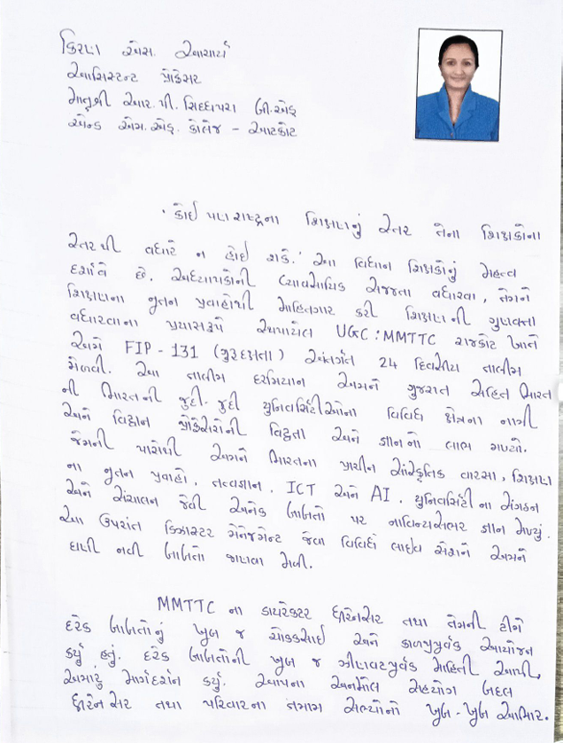
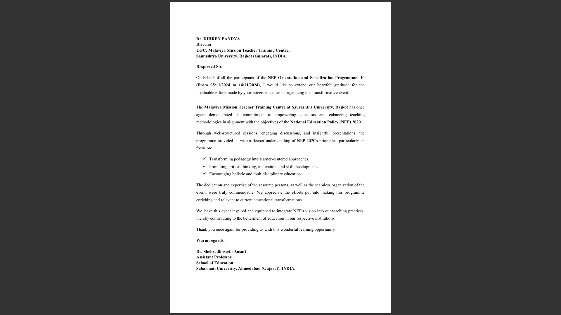
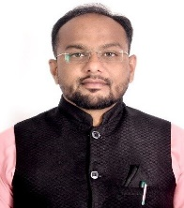
Testimonials from Participants

Slide 17
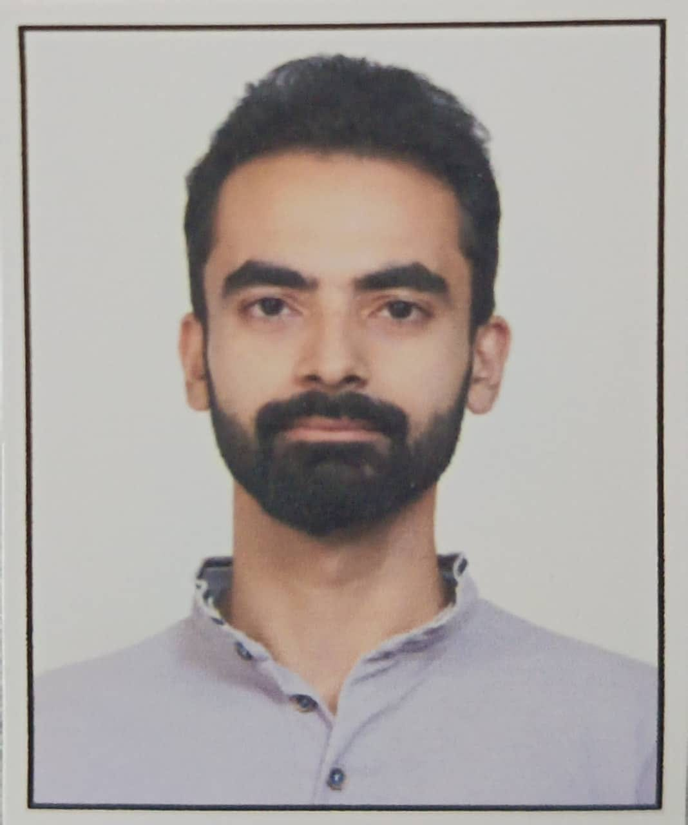
Testimonials from Participants
The Faculty Induction Programme (FIP-128) (11/09/2023 to 07/10/2023) organized by UGC:MMTTC, Saurashtra University, was an enriching and comprehensive experience. The program covered a wide range of topics, from traditional Indian knowledge systems like Upanishads and Darshan Granth to modern educational tools such as AI in education and Learning Management Systems (LMS). The sessions on NEP 2020 and regulatory bodies provided valuable insights into the evolving landscape of higher education in India.
Google Drive Links of Participant Feedback/ Testimonials
https://drive.google.com/file/d/1HAoK3AFZ0vUN7xuWXnfTNEnW0T29wGgb/view
https://drive.google.com/file/d/1WizI3gSQ5Ko5RCxnkw8IhIIbIdmmVDqd/view?usp=drive_link
https://drive.google.com/file/d/1x10kYEPe6MsYhcAR6vYVt6vAYMpRR7hu/view?usp=drive_link
https://drive.google.com/file/d/1mwhxAIQoPqSnmCxbZWEAODUFxaAAEF5/view
(Please Ctrl + Click the link to play the video)
Case studies and micro-teaching exercises were particularly effective in enhancing practical teaching skills. The inclusion of yoga and ethical publication practices added a holistic dimension to the program. Overall, the FIP was well-structured, informative, and highly beneficial for professional growth as an academician. The facilitators were knowledgeable, and the interactive sessions fostered a collaborative learning environment. I would like to extend my heartfelt gratitude to the UGC: MMTTC, Saurashtra University, and all the organizing authorities for their efforts in conducting such a well-planned and impactful program. Thank you!
- Dr. Kishan M. Badiyani,
Government Commerce College, Jamnagar, Gujarat.

Slide 18
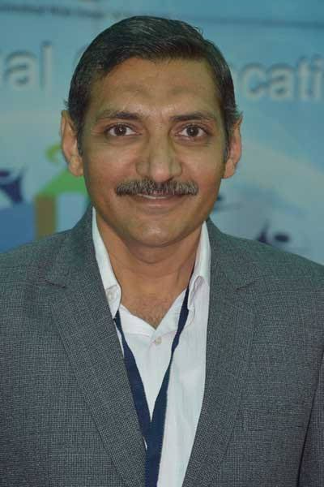
A Message of Gratitude and Commitment
As Director of the M. M. T. T. C., I extend my sincerest gratitude for your unwavering dedication to shaping future generations. Our commitment to fostering innovation and excellence in education is truly commendable. The M. M. T. T. C. Rajkot remains steadfast in its mission to empower cutting-edge training and resources, ensuring the forefront of pedagogical advancements. We at MMTTC, Rajkot always look forward to our continued collaboration in elevating educational standards and nurturing a vibrant learning ecosystem.
Sincerely Yours,
Dr. Dhiren D. Pandya
Director
UGC:MMTTC
Saurashtra University
Rajkot.

